Slide 1


Personal Health Advisor
~Your Health, Your Way

Slide 2
Problem Statement:
Accessing personalized health analysis and lifestyle recommendations based on one’s medical input information remains a challenge. Many individuals struggle to understand their symptoms, assess basic health risks, and find trustworthy information about diseases. The absence of a centralized, intelligent, and user-friendly platform often leads to confusion, misinformation, and delayed action.
What if an AI-powered virtual health assistant could help users analyze their symptoms, assess lifestyle-related health risks, explore detailed disease information, receive personalized health analysis—including BMI, diet, and exercise tips—and get instant answers to health-related questions?

Slide 3
Our Solution:
Provides tailored insights on BMI, diet, and exercise based on user input.
Predicts possible diseases from selected symptoms with confidence levels.
Calculates the risk of heart disease and diabetes using health parameters.
Offers clear information on diseases, medications, diet, and precautions.
Answers general health questions in real-time through a smart chatbot.

Slide 4

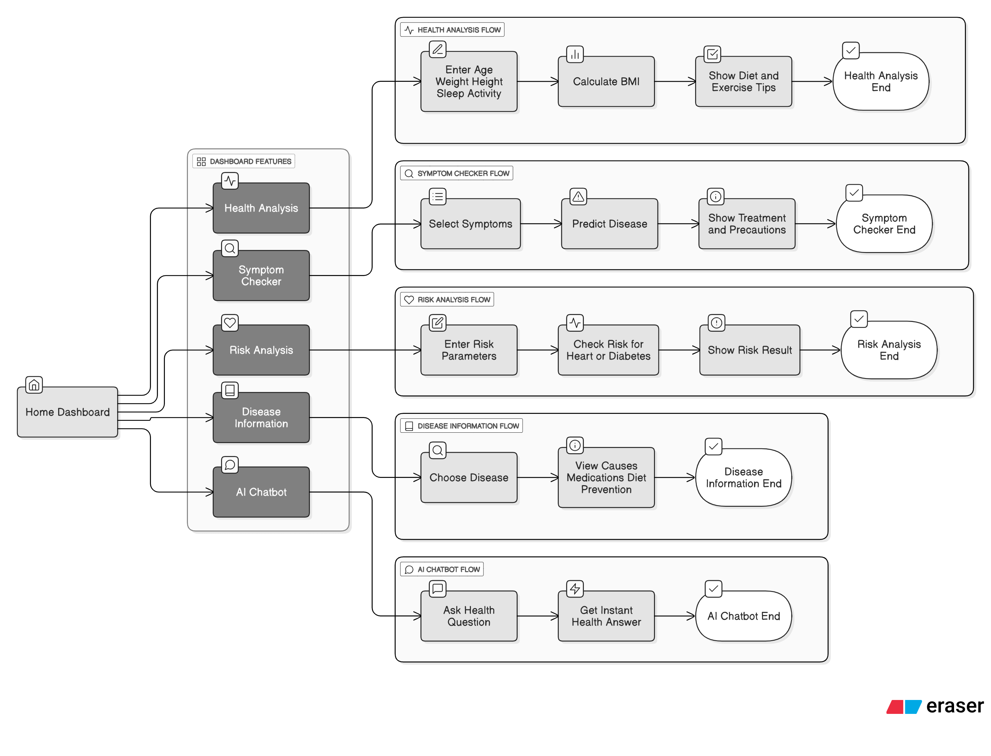
User Flow:

Slide 5

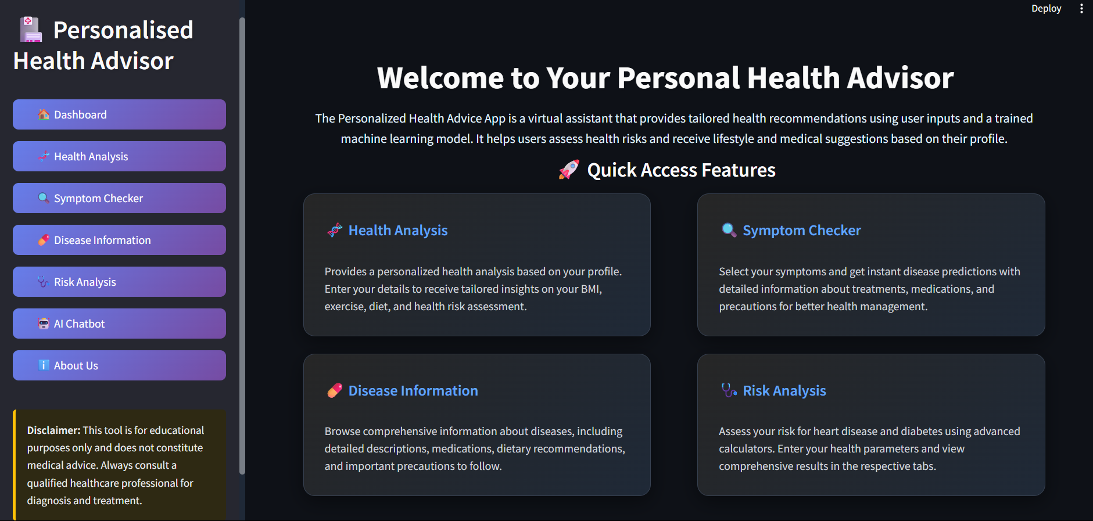
Features

Slide 6
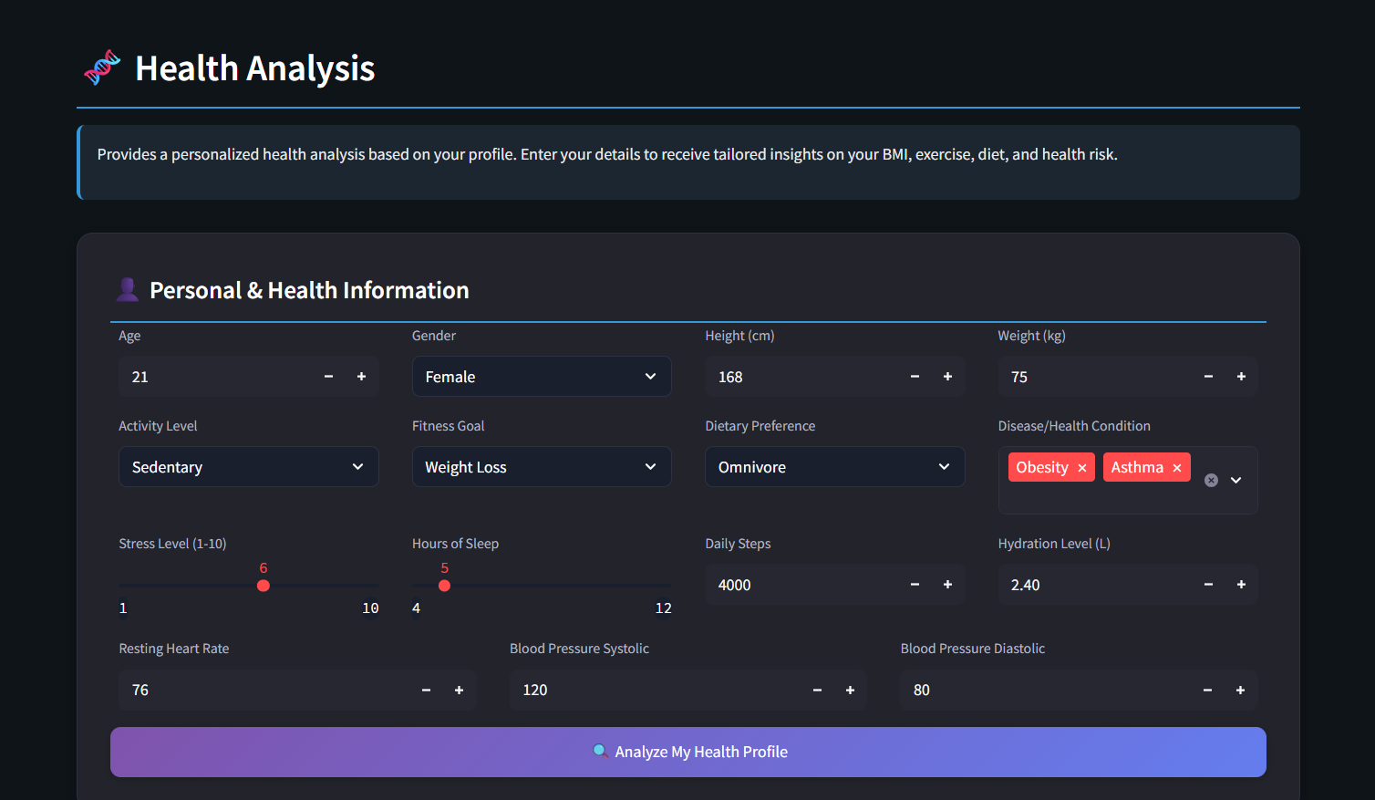
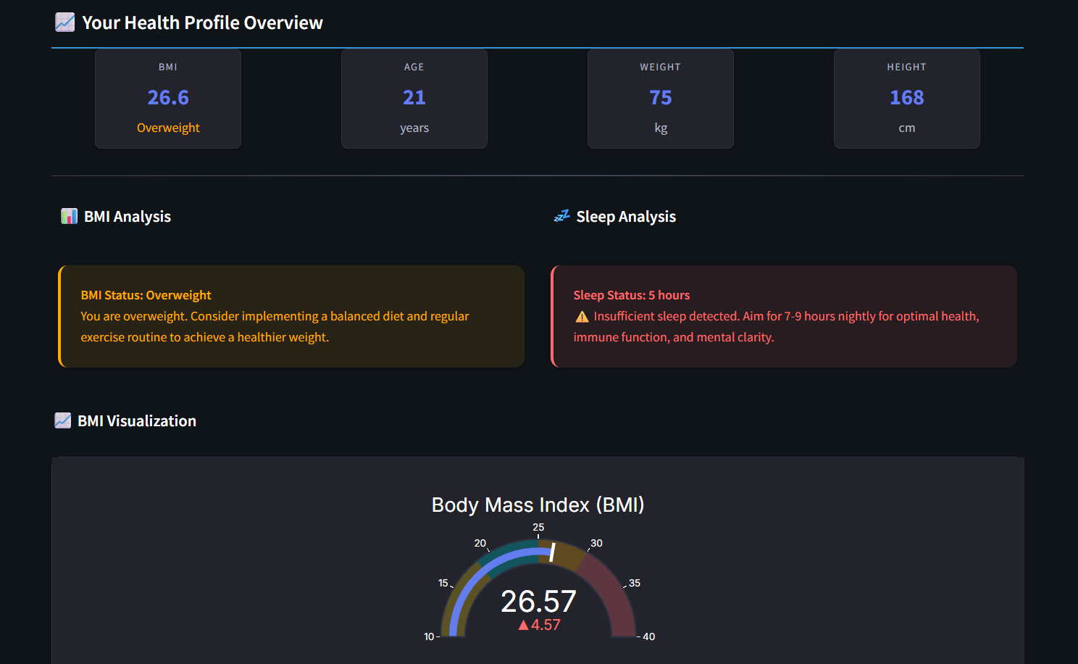
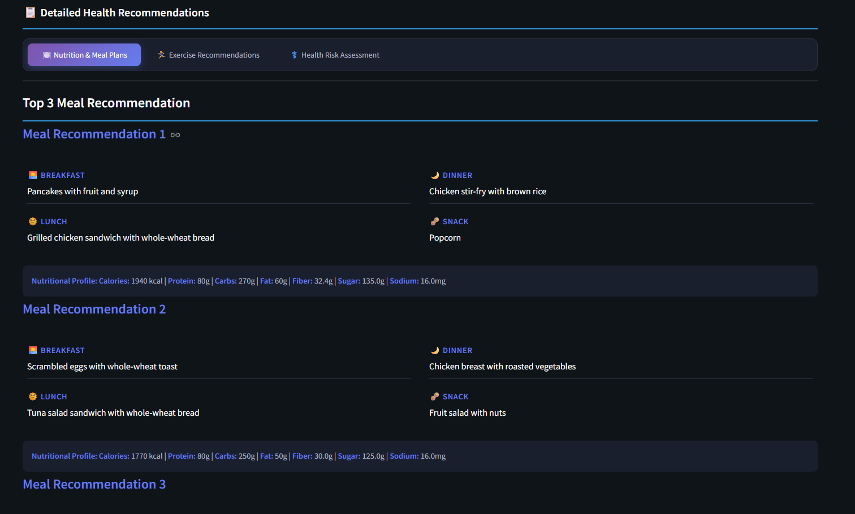
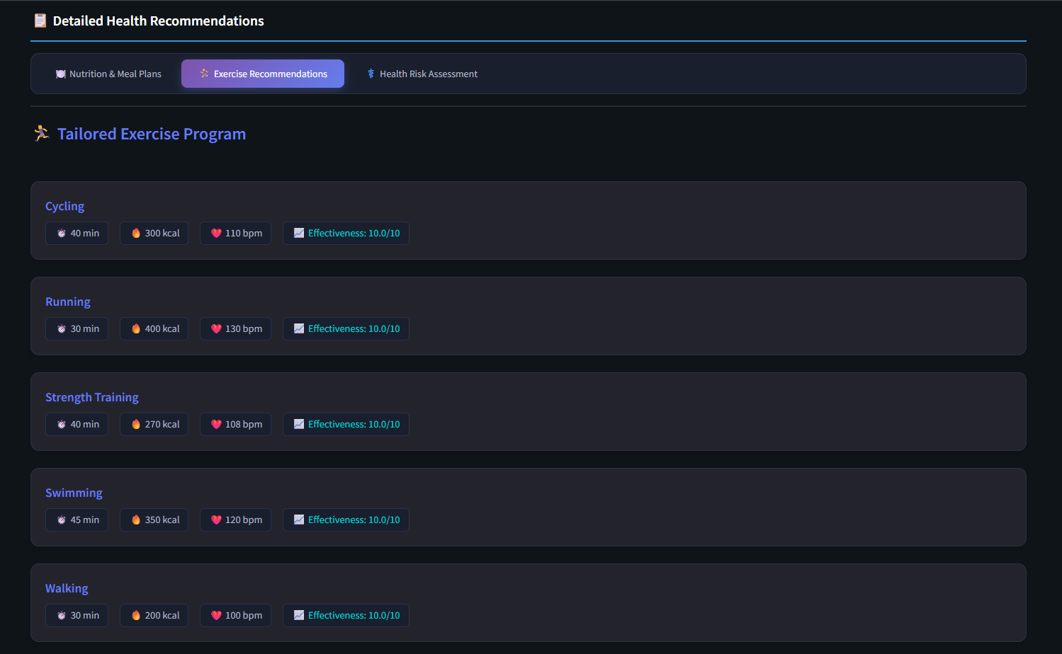
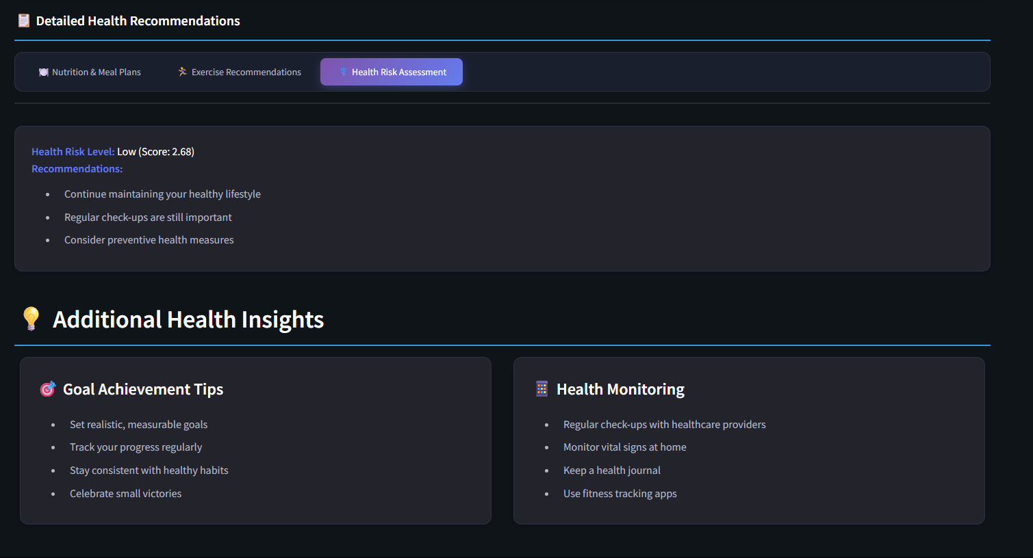
01
Personalized Health Analysis:
Provides tailored insights on BMI, diet, and exercise based on user input.

Slide 7
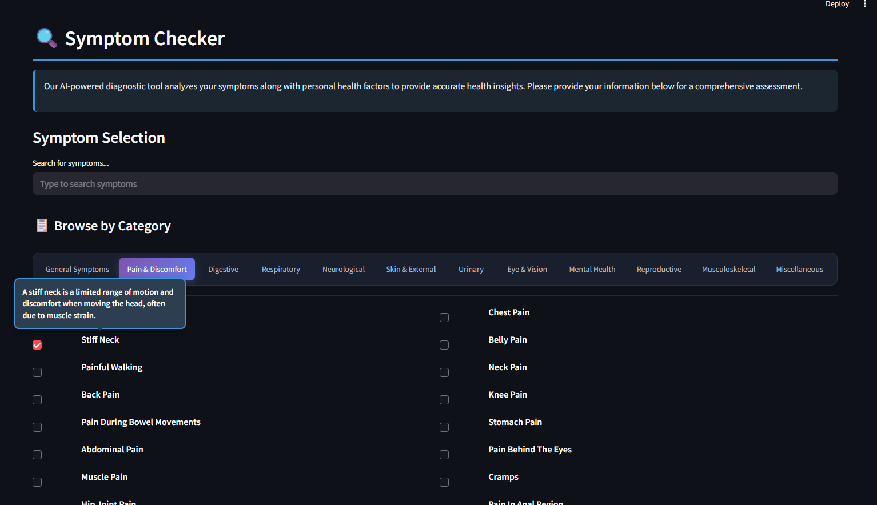
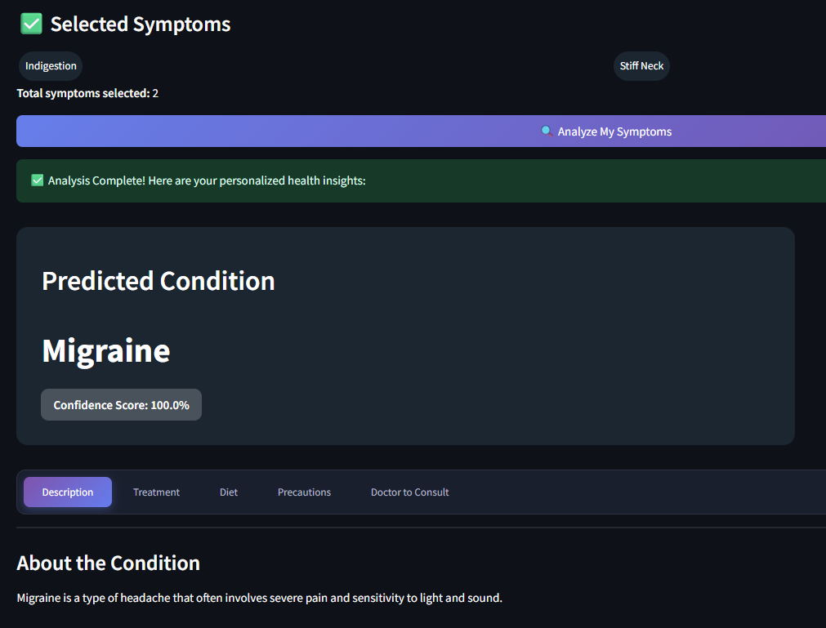
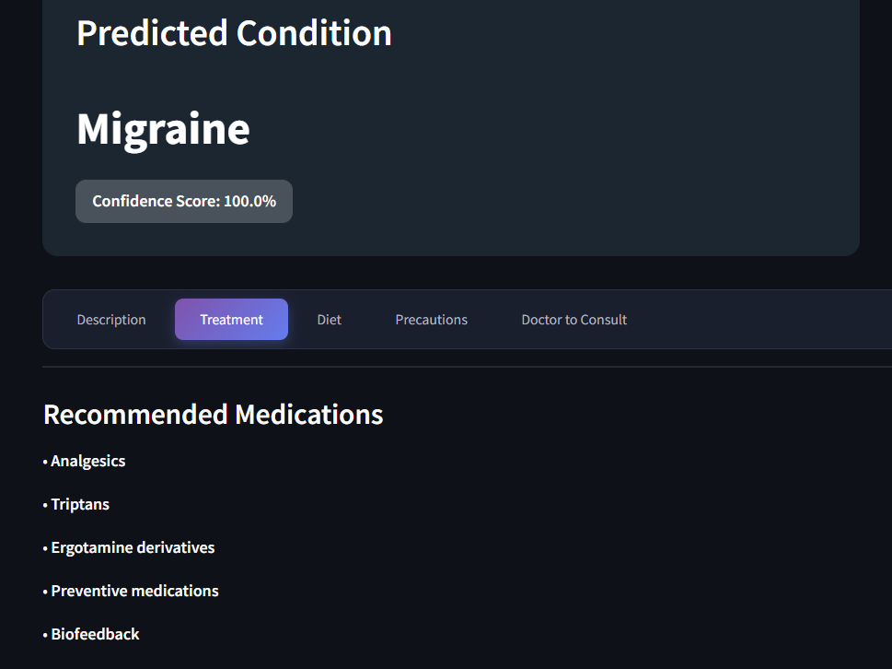
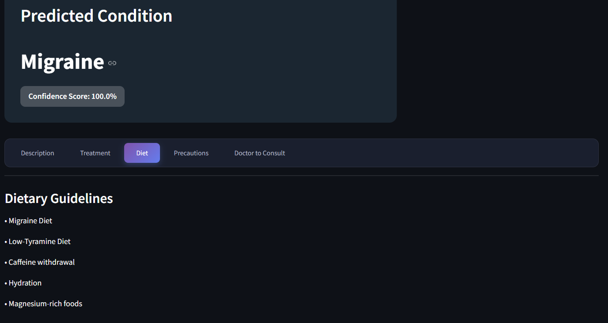
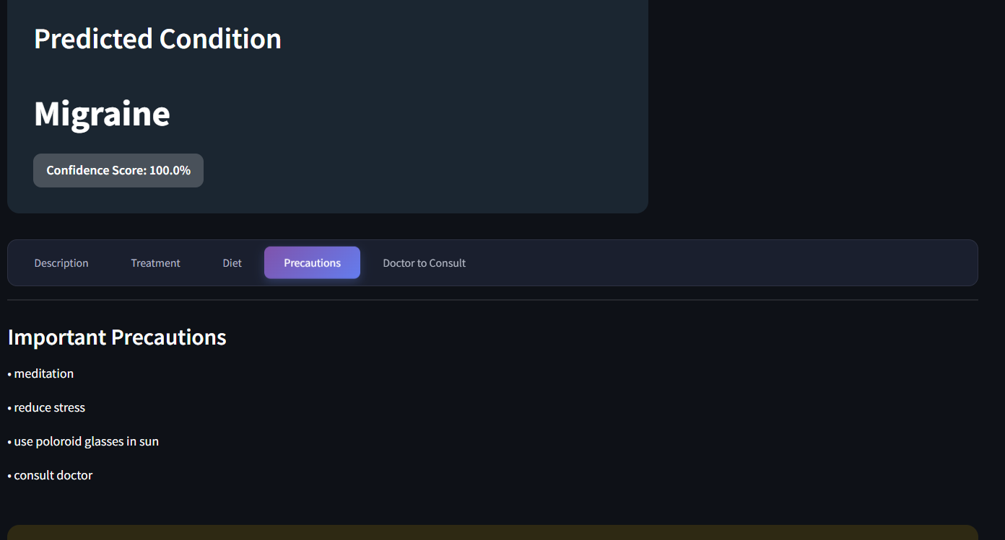
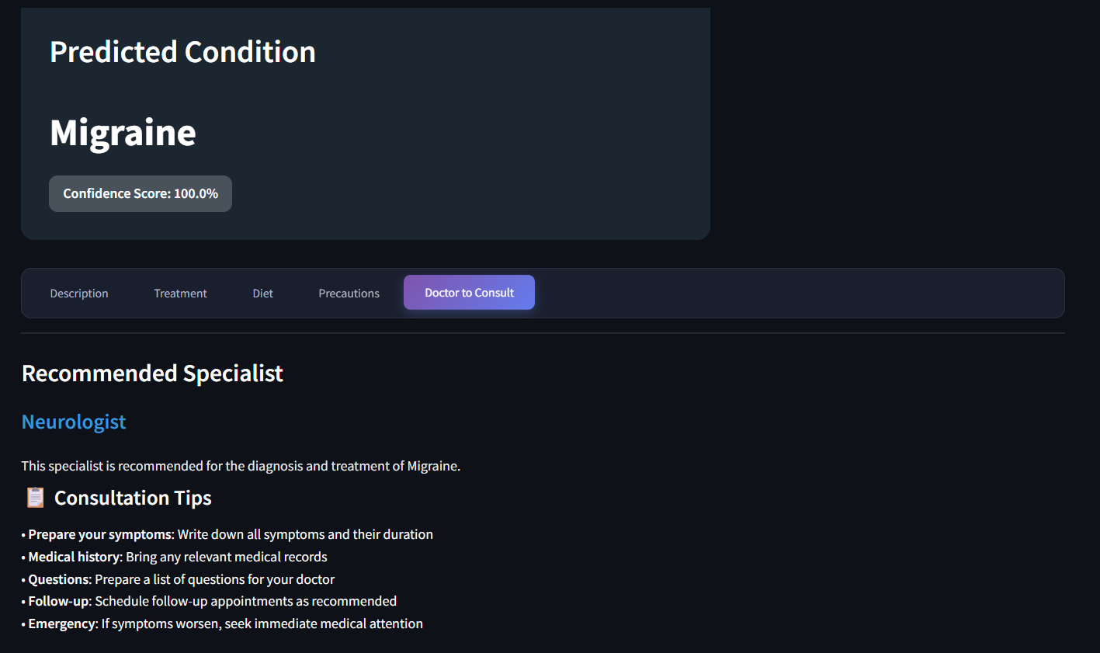
02
Symptom Checker:
Predicts possible diseases from selected symptoms with confidence levels.

Slide 8
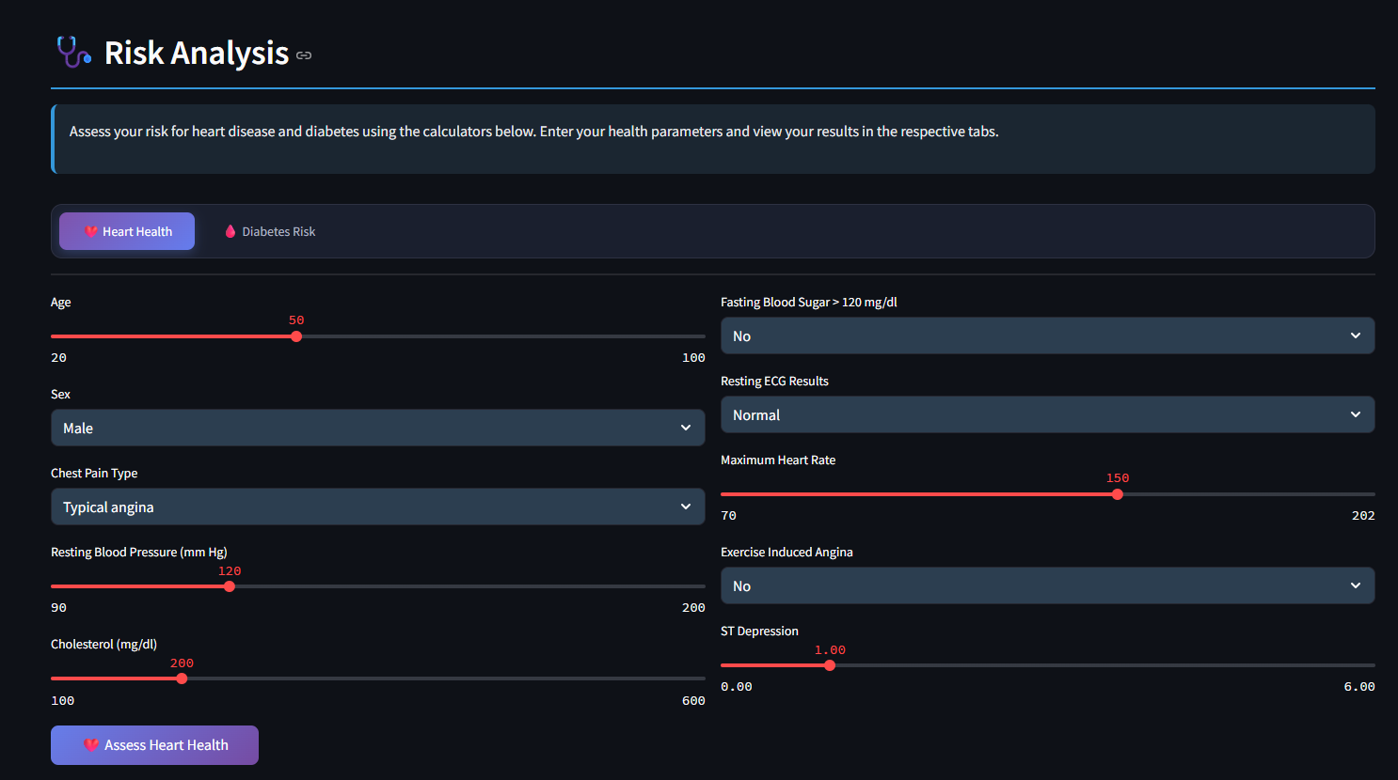
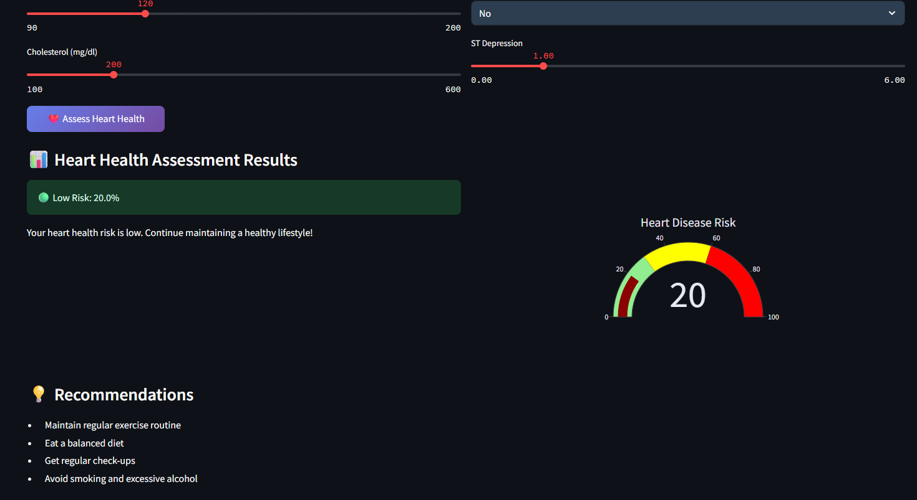
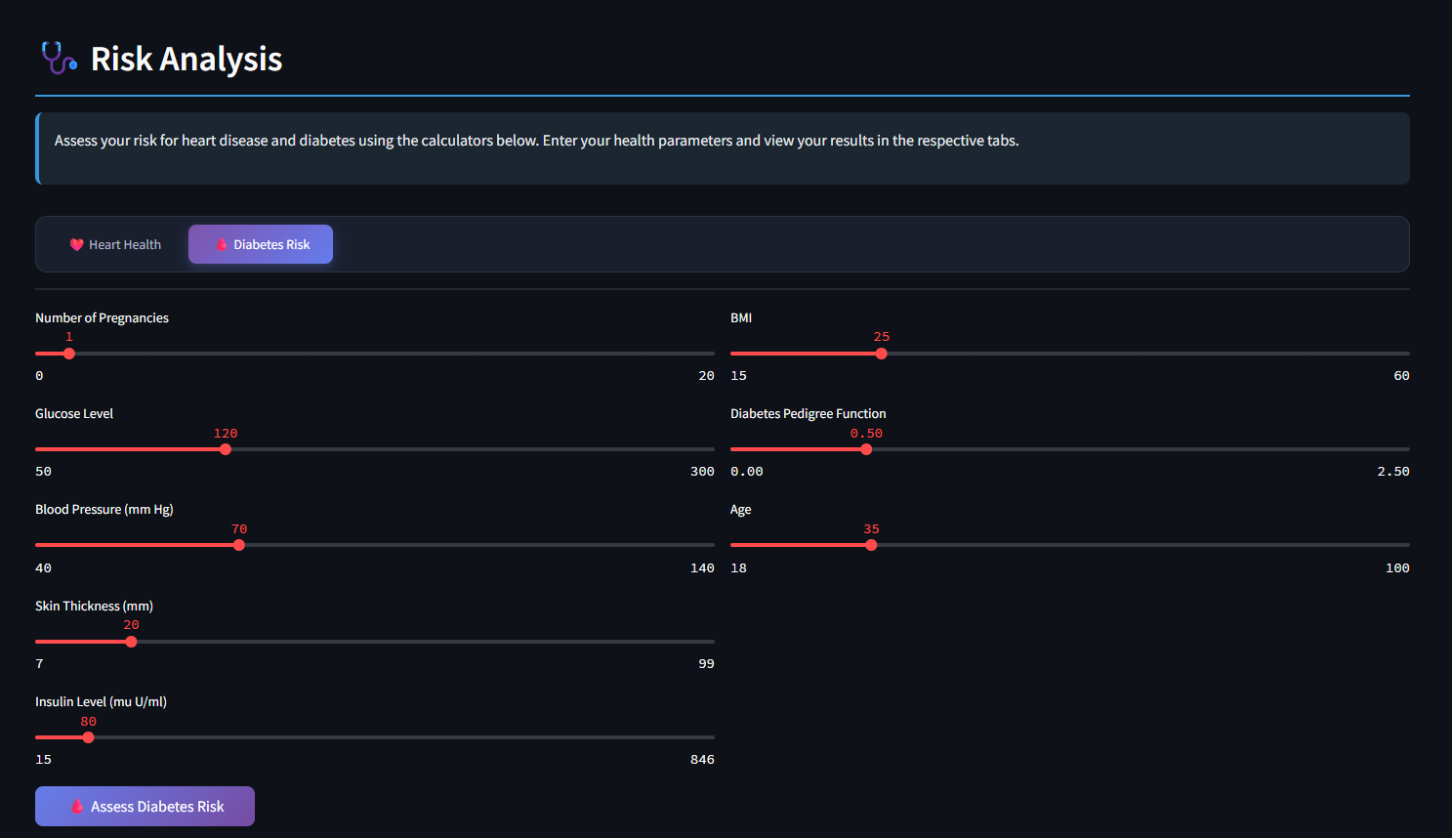
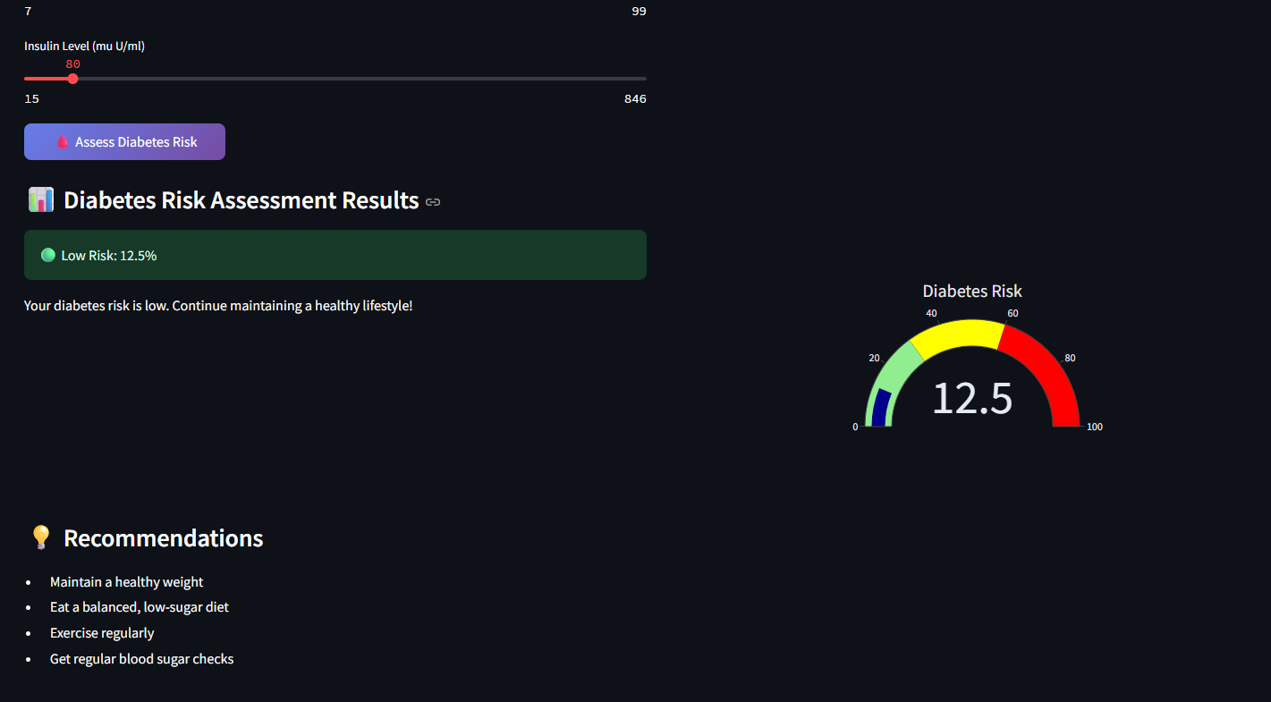
Heart Health
03
Risk Analysis:
Calculates the risk of heart disease and diabetes using health parameters.
Diabetes Risk

Slide 9
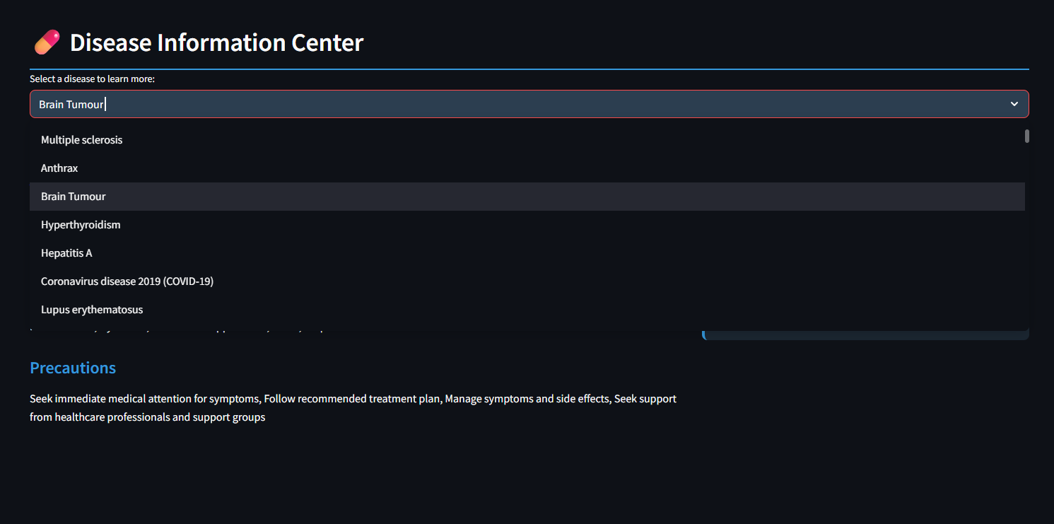
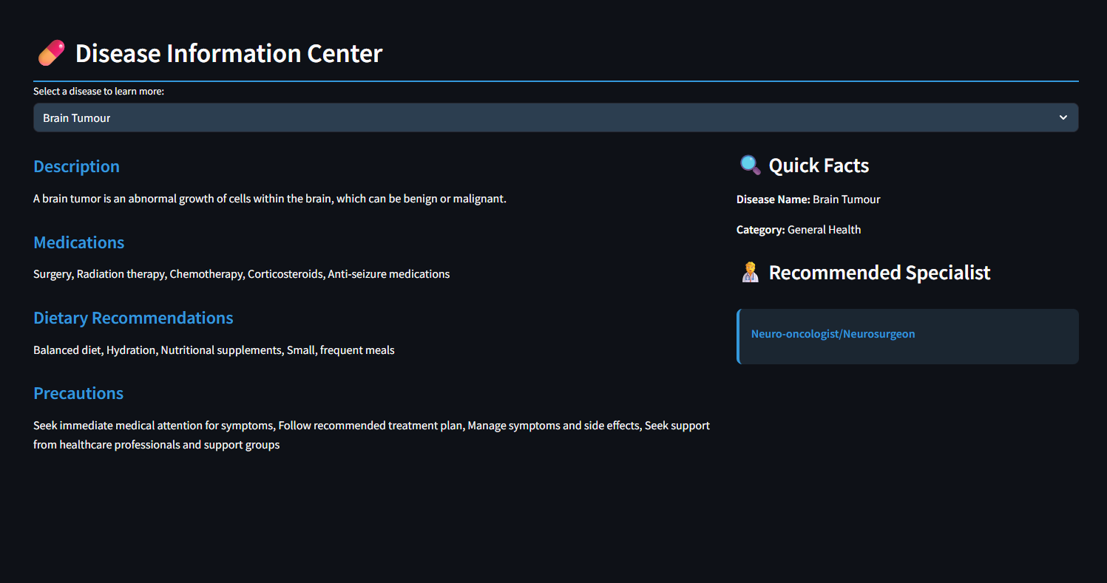
04
Disease Information:
Offers clear information on diseases, medications, diet, and precautions.

Slide 10
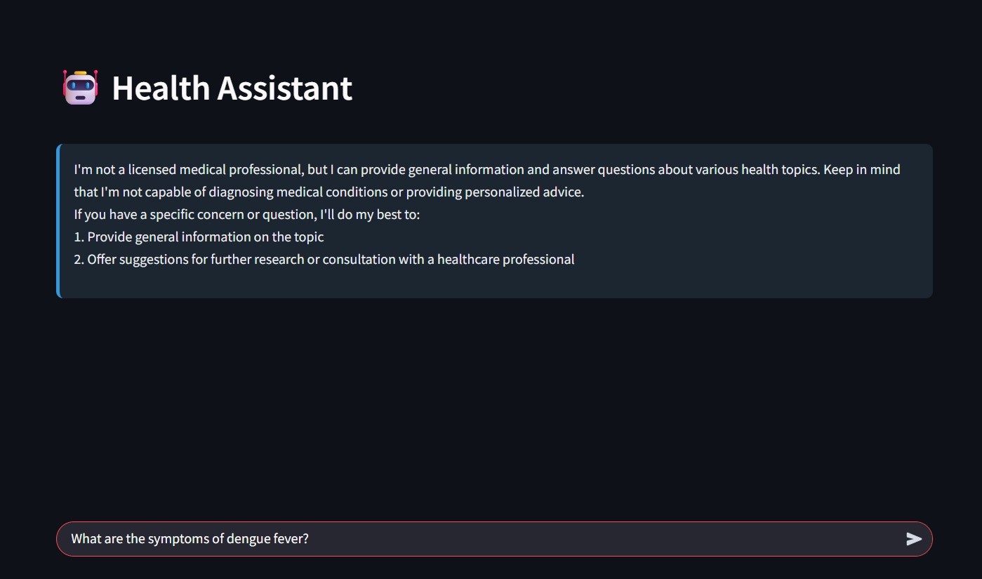
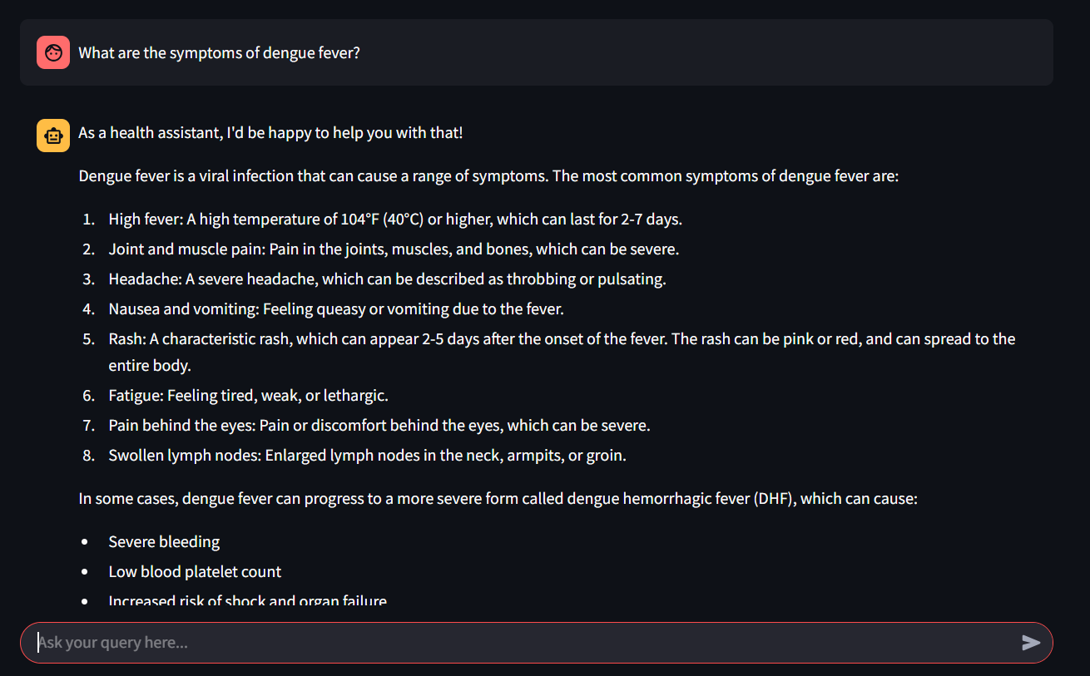
05
AI Chatbot Support:
Answers general health questions in real-time through a smart chatbot.

Slide 11
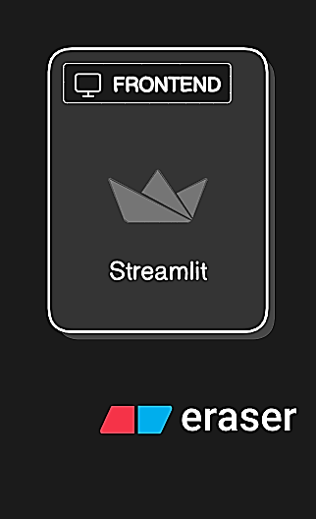
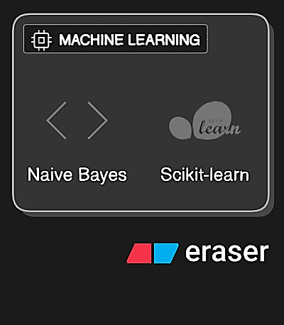
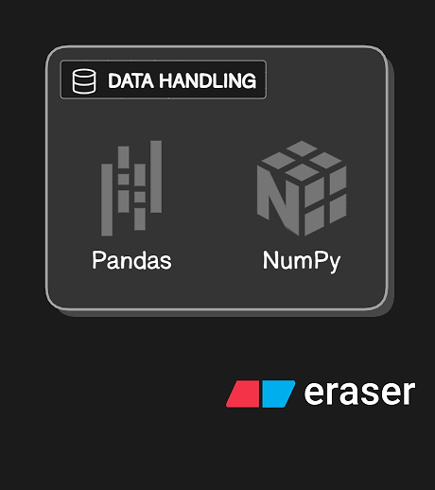
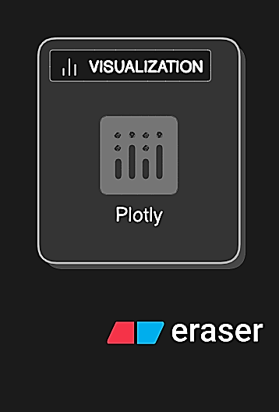
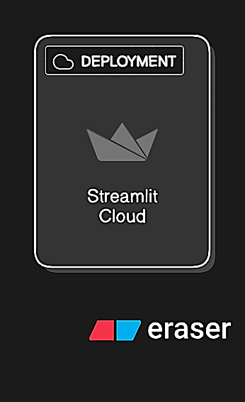
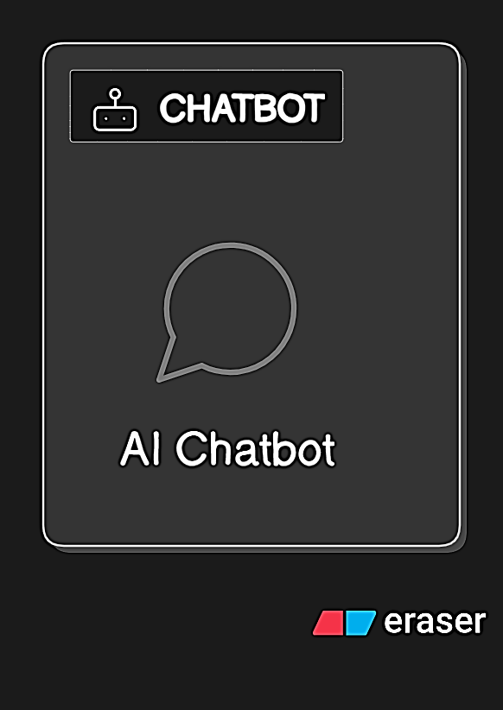
Technology Stack :

Slide 12

MVP Scope:
Personalized Health Analysis
Symptom checker
Disease info display
Risk Analysis
Basic AI chatbot

Slide 13
Competitive Advantage:
Comprehensive multi-tool app in one platform
User-friendly interface
Personalized AI responses
Real-Time AI Chatbot for Health Queries
Cost-effective & accessible 24/7

Slide 14
Meet the Team:
Usha Kiran Paruchuri
Jakka Charishma
Kakumanu Ravi Chandra
Mandadapu Prabhas
Github link: https://github.com/UshaKiran31/Personalised-Health-Advisor
Deployed link: https://personalised-health-advisor.streamlit.app/

Slide 15


Thank You!
~Empowering health, one user at a time.

